Slide 1
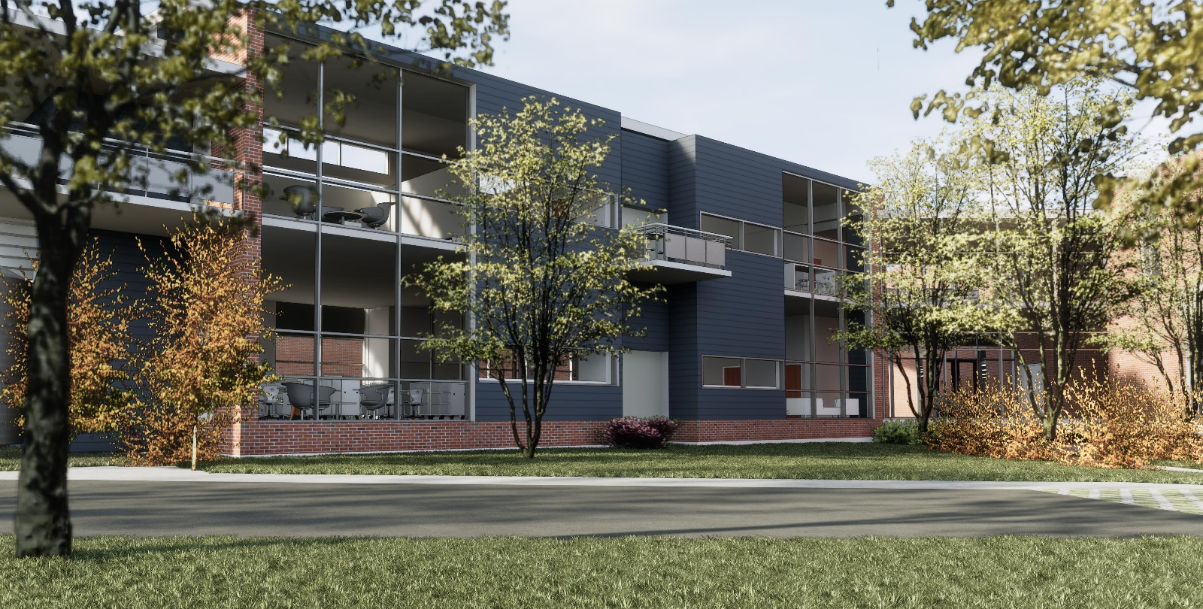


WAHS SCIENCE LABS
ADDITION AND MODERNIZATION
Albemarle County Public Schools
November 9, 2017
DESIGN DEVELOPMENT

Slide 2
OWNER:
Albemarle County Public Schools
Contact: Sheila Hoopmann + Matt Wertman
shoopmann@albemarle.org
mwertman@albemarle.org
ARCHITECT:
CIVIL ENGINEER:
VMDO Architects
200 E Market St.
Charlottesville, VA 22902
(434)296-5684
www.vmdo.com
Contact: Ken Thacker
kthacker@vmdo.com
Timmons Group
608 Preston Avenue, Suite 200
Charlottesville, VA 22903
(434)327-1668
www.timmons.com
Contact: Craig Kotarski
Craig.Kotarski@timmons.com
MEP ENGINEER:
STRUCTURAL ENGINEER:
Lawrence Perry & Associates
15 E. Salem Avenue, SE, Suite 101
Roanoke, Virginia 24011
(540)342-1816
lpa-inc.com
Contact: Rick Hughes
RHughes@lpa-inc.com
Fox + Associates, PC
12085 Gayton Road
Richmond, VA 23238
(804)750-2085
www.foxengineers.com
Contact: John Ireland
jireland@foxengineers.com
PROJECT TEAM

Slide 3
PROJECT DESCRIPTION:
ORIGNAL Scope:
10,000 SF, 2-story Addition
8,000 SF Renovation
3,000 SF “Modernization”
Miscellaneous “daylighting” in (7) rooms
Budget:
$4.9 million
Schedule:
Phase I renovation completion: Fall 2018
Phase II renovation / addition completion: Fall 2019
CURRENT Scope:
7,900 SF, 2-story Addition
8,000 SF Renovation and Modernization
½ acre Outdoor Learning Space (Note: 32 parking spaces will be eliminated)
Miscellaneous “daylighting” in (7) rooms
Budget:
$4.9 million
Schedule:
Phase I renovation completion: Fall 2018
Phase II renovation / addition completion: Fall 2019
PROJECT OVERVIEW

Slide 4
SCHEDULE and BUDGET:
We are ON BUDGET according to our reconciled Schematic Design Phase cost estimate.
We are ON SCHEDULE; currently in the Design Development phase, roughly half-way through the overall planning process.
1. PROJECT STATUS

Slide 5
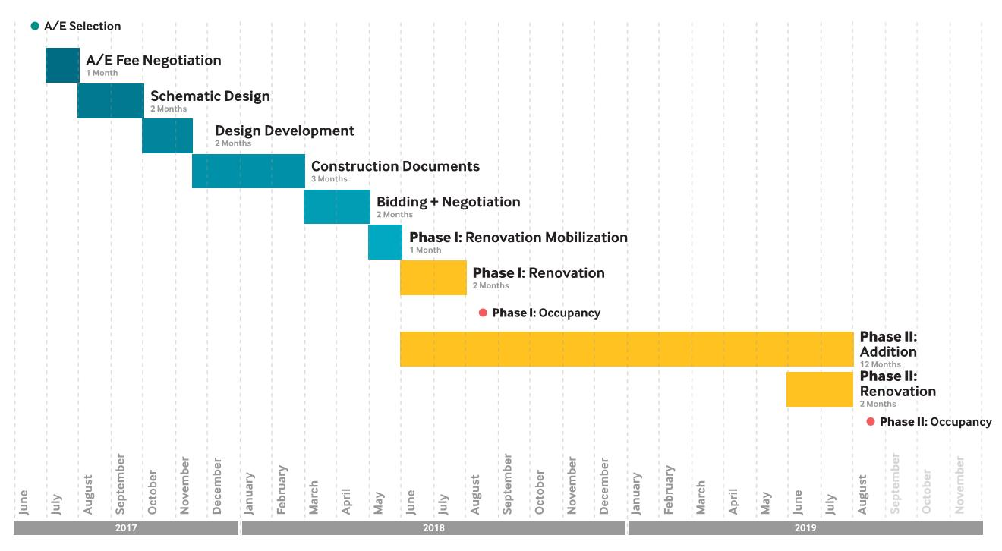
1. PROJECT STATUS

Slide 6
REMAINING SCHEDULE:
NOV 09 | School Board Presentation | Design Development
NOV 13 | Design Development #3 | Admin + Teachers | CTE
NOV 14 | DD Teacher Workshop #2 | Teachers + Ray | Discussion + Survey
NOV 28 | DD Teacher Workshop #2 | Teachers + Ray | Development of Ideas
DEC 4 | Design Development #4 | Admin + Teachers | Medium/high Intensity, sinks, storage, furniture
DEC 12 | DD Teacher Workshop | TBD
JAN 08 | Design Development #5 | Admin | Technology, Add Alts, Construction Phasing
JAN 29 | Design Development #6 | Finalize Design Development
FEB 22 | Documents Released for Bidding | Concludes Design Development
1. PROJECT STATUS

Slide 7
CONSULTANT INVOLVEMENT:
Civil engineers are preparing for County site plan review.
MEP Engineers are investigating existing conditions, paying particular attention to above-ceiling conditions.
Lab planning consultant meetings will be held with the science teachers in the coming weeks.
2. CONSULTANT INVOLVEMENT

Slide 8
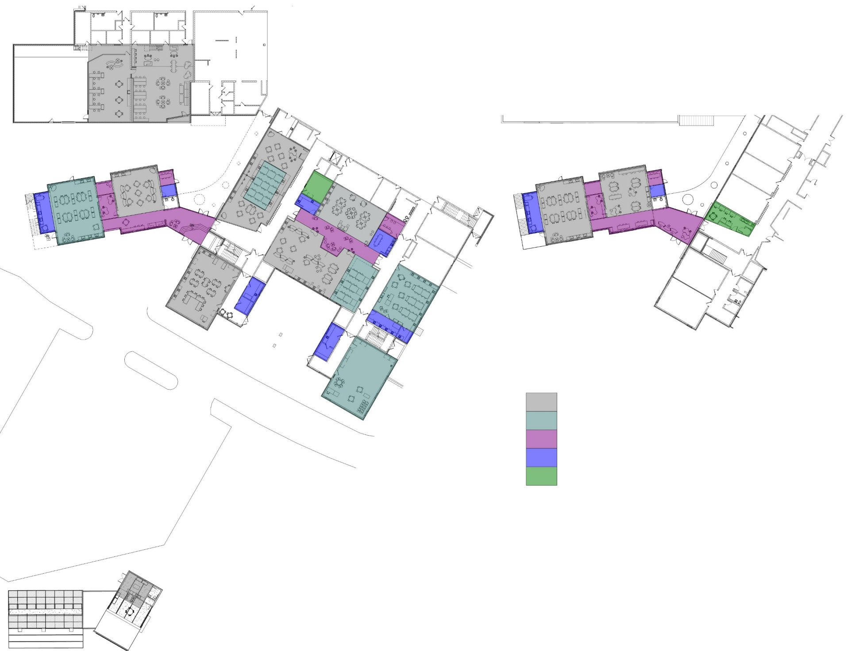
FIRST FLOOR
SECOND FLOOR
MEDIUM INTENSITY LAB
HIGH INTENSITY LAB
PROJECT ROOM / BREAKOUT SPACE
PREP ROOMS
TEACHER OFFICE
3. TEACHER INPUT

Slide 9
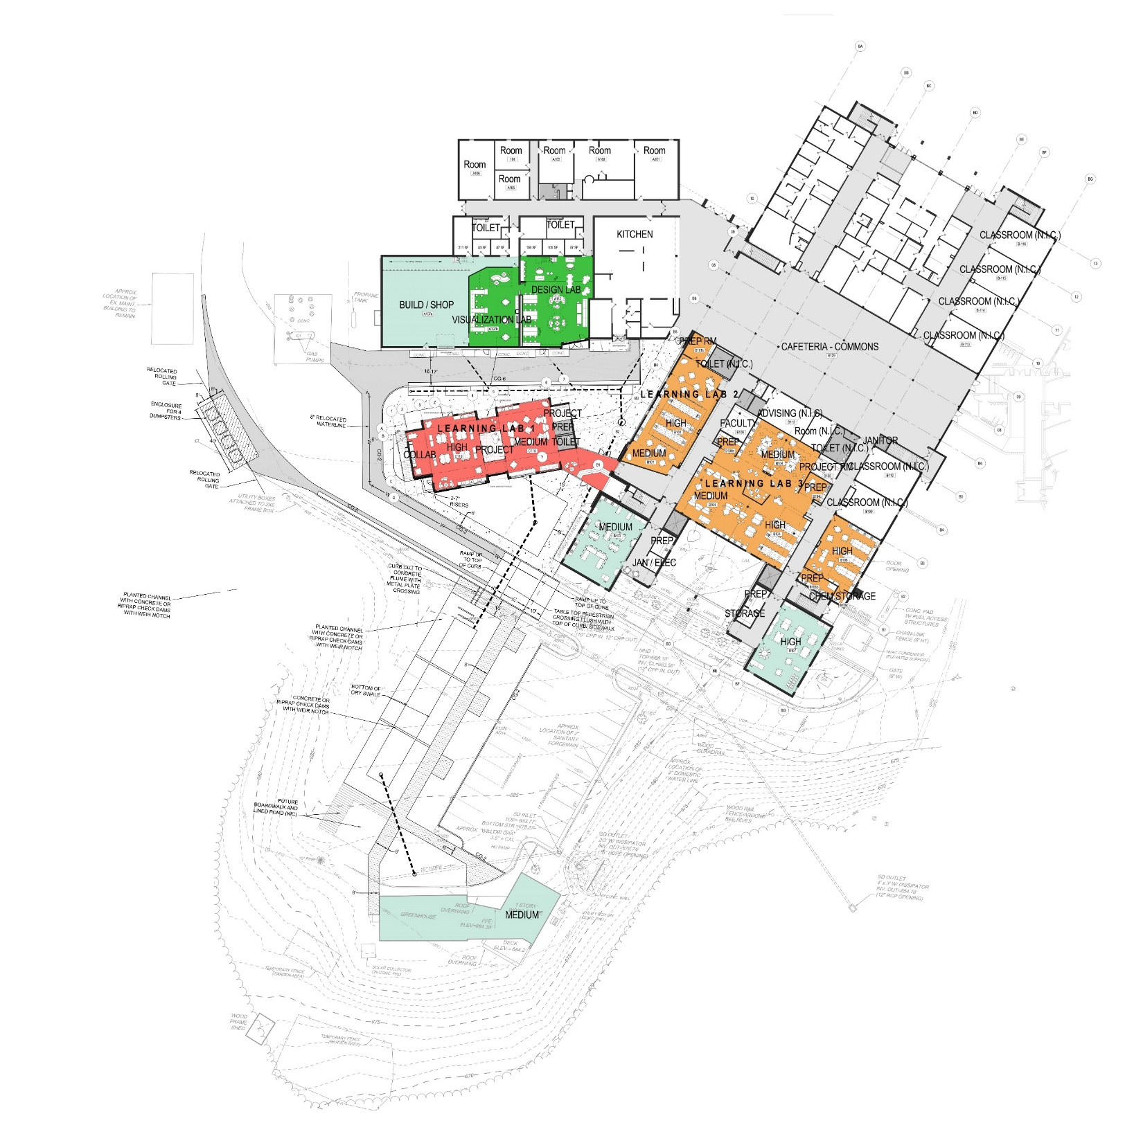
SCOPE CHANGES SINCE SCHEMATIC DESIGN APPROVAL:
4
Omitted water storage cistern to feed storm water learning gardens.
Limited scope of interior renovations but still over what had initially been identified.
Request to add courtyard landscaping and new exterior doors.
2
1
3
4. SCOPE CHANGES

Slide 10
LOOKING AHEAD:
Meeting with CTE faculty next week.
On-going design review meetings with administrators and faculty are planned through January.
Confirming budget status with DD estimate later this month.
Documents will go out for bidding on February 22, 2018.
5. LOOKING AHEAD

Slide 11
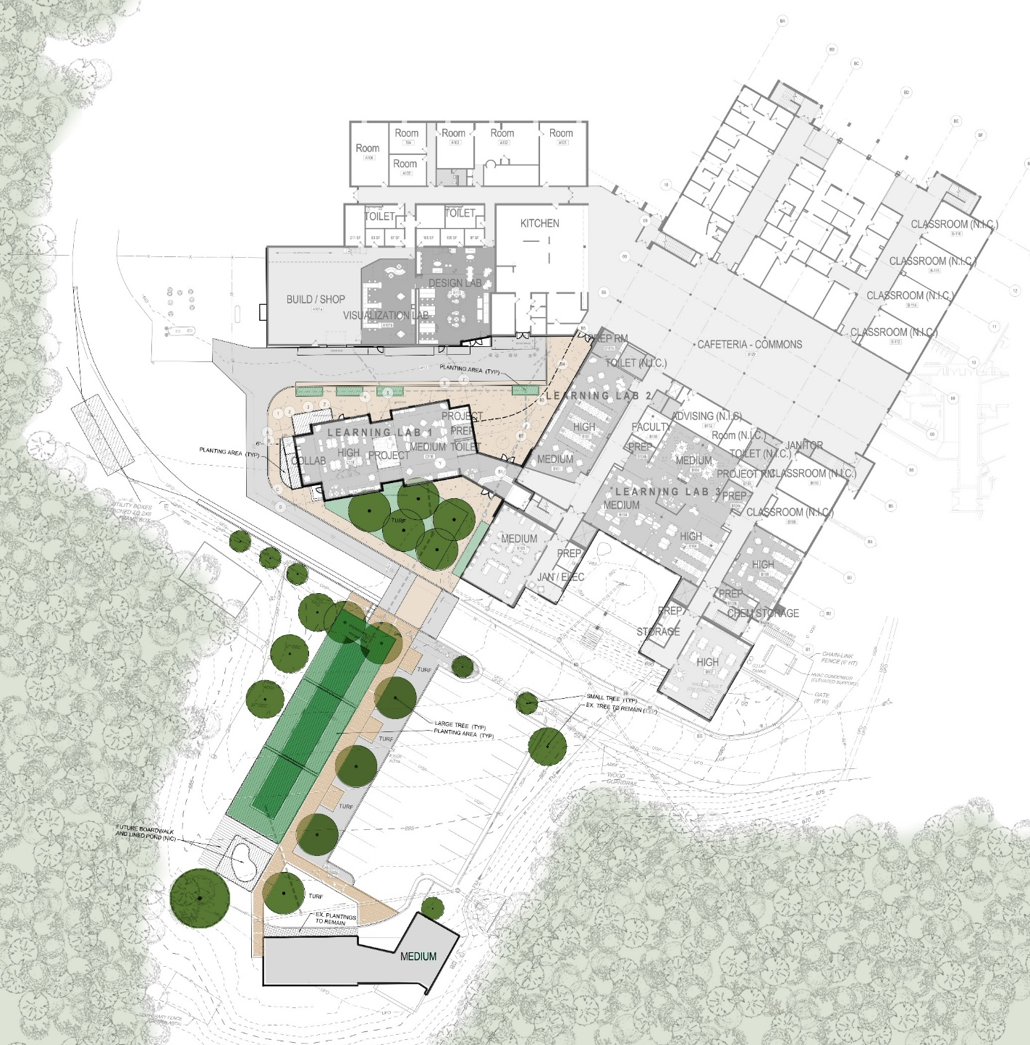
SITE PLAN

Slide 12

FIRST FLOOR PLAN

Slide 13
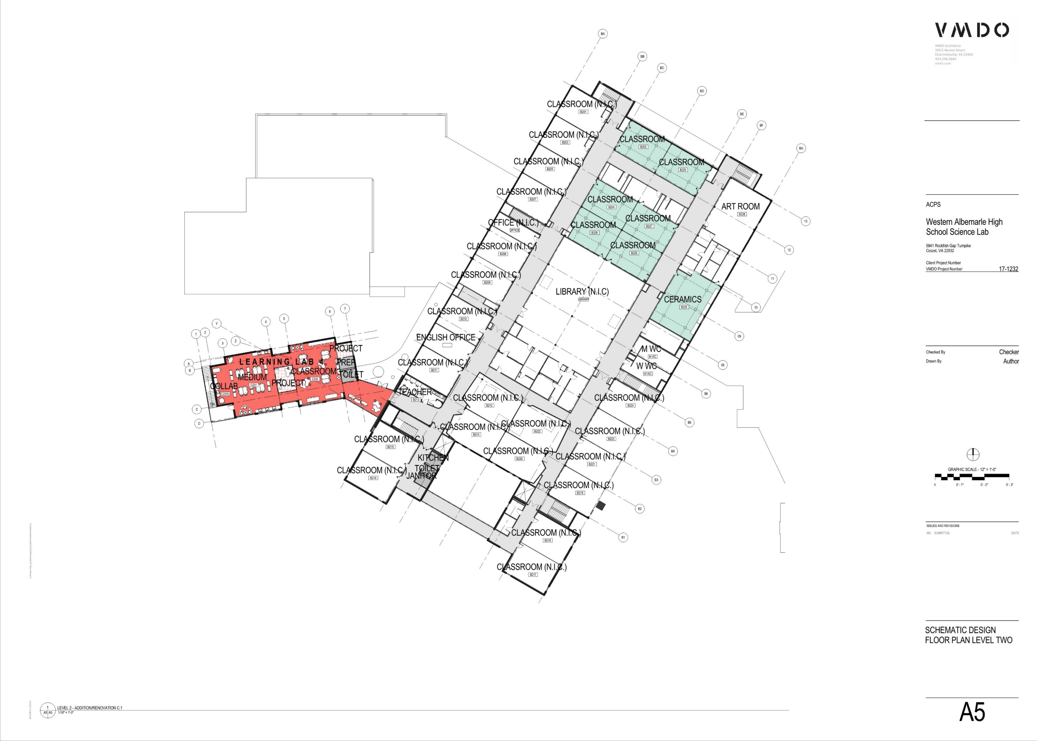
SECOND FLOOR PLAN

Slide 14
SECOND FLOOR PLAN

Slide 15
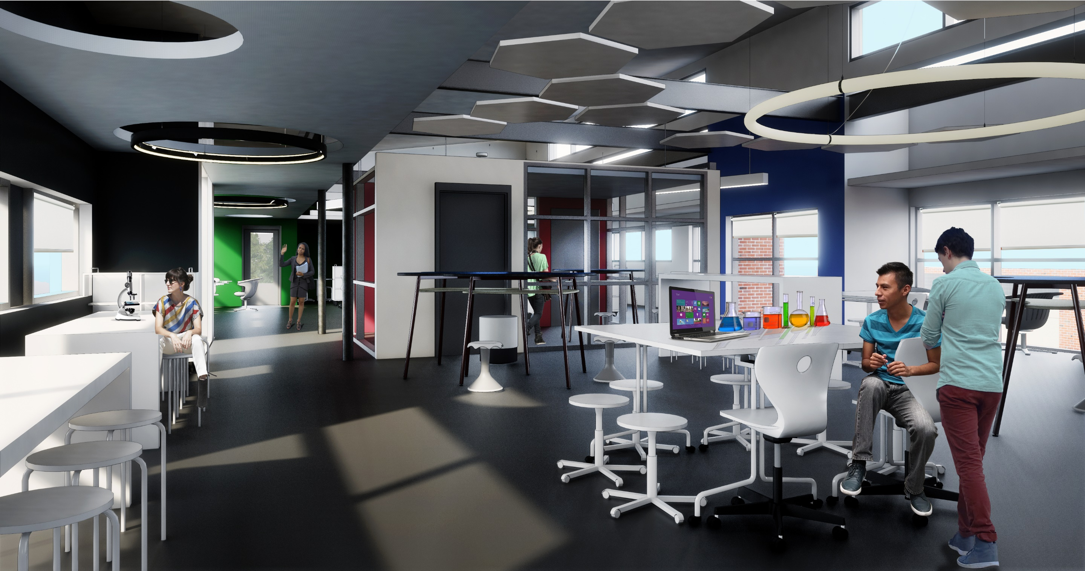
ADDITION | INTERIOR VIEW OF LEARNING LAB ONE
PICTORIAL VIEWS

